Slide 1



INTERNET OF THINGS
Topic name:
INTELLIGENT door ACCESS MANAGEMENT SYSTEM
Team Name:
Smart Hackers
TEAM MEMBERS:
Keesari Sowmya
Vineetha Maganti
P.Ravija

Slide 2
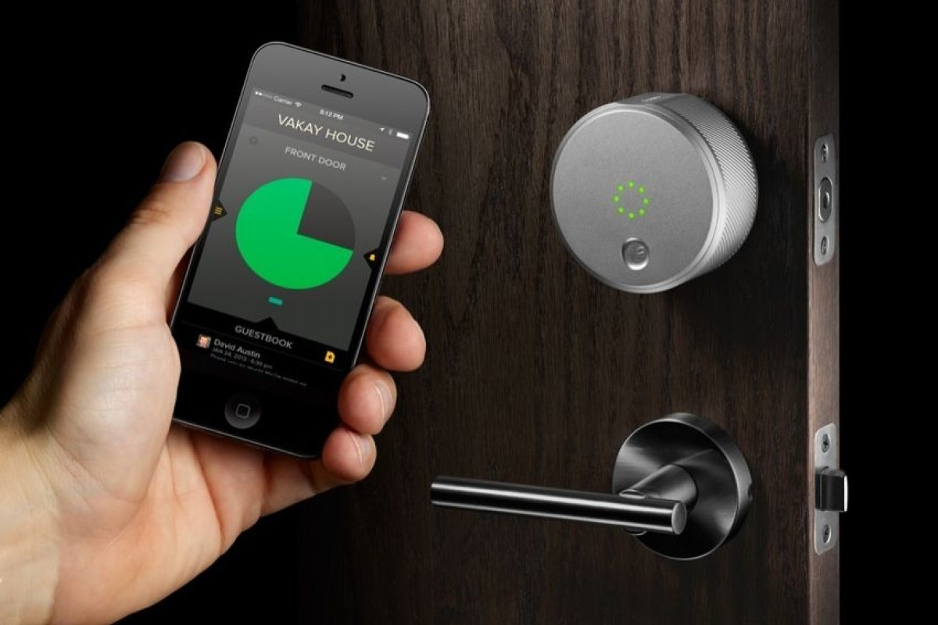
ABStract
Main purpose is to design a system which control’s door using smart security web service. This system mainly consists of web camera to detect guest, Raspberry Pi which have in- built Wi-Fi module and a device for interfacing with system.
Whenever an individual would stand in front of door then camera will detect and send image on the device. User can control the door by using the web service.

Slide 3

SOLUTION
The solution to intelligent access management system is to create the application that can recognize the motion of the objects and can detect the face .After the picture of the if detected and sent it the cloud .
The components we used in this project are:
→IR Sensor ---- to detect the presence of human
→Servo Motor ---- to rotate the motor …..,in case to open the door by using the intelligent assistants
→USB Camera---- to take the snap shots of the object or the face detected person
→Raspberry pi

Slide 4
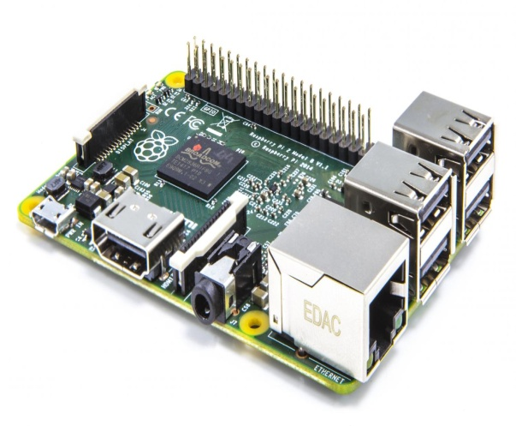
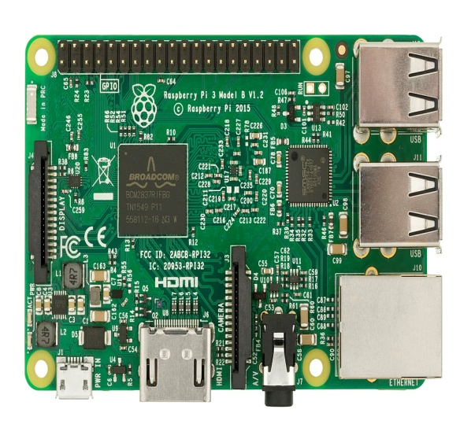
RASPBERRY PI
The working principal is like any modern PC. They include a processor, memory, storage (SD card) video (HDMI), network (10/100 Ethernet) AND IO (four USB 2.0 ports). The power supply is a micro USB connector, and it’s happiest with 5–5.2 volts at 2.5A.Raspberry pi consists of 40 GPIO pins .

Slide 5
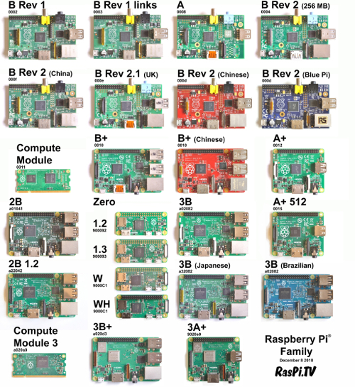

Slide 6
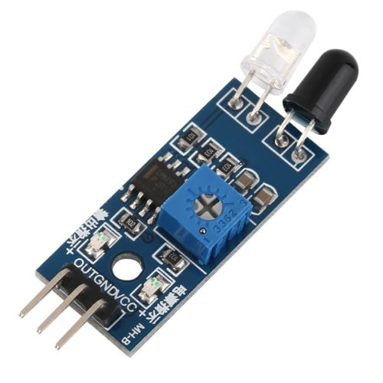
IR Sensor
An infrared sensor is an electronic device, that emits in order to sense some aspects of the surroundings. An IR sensor can measure the heat of an object as well as detects the motion. These types of sensors measures only infrared radiation, rather than emitting it that is called as a passive IR sensor.
IR sensors are classified into different types depending on the applications. Some of the typical applications of different types of sensors are
Speed sensor
Temperature sensor
PIR sensor
Ultrasonic sensor

Slide 7

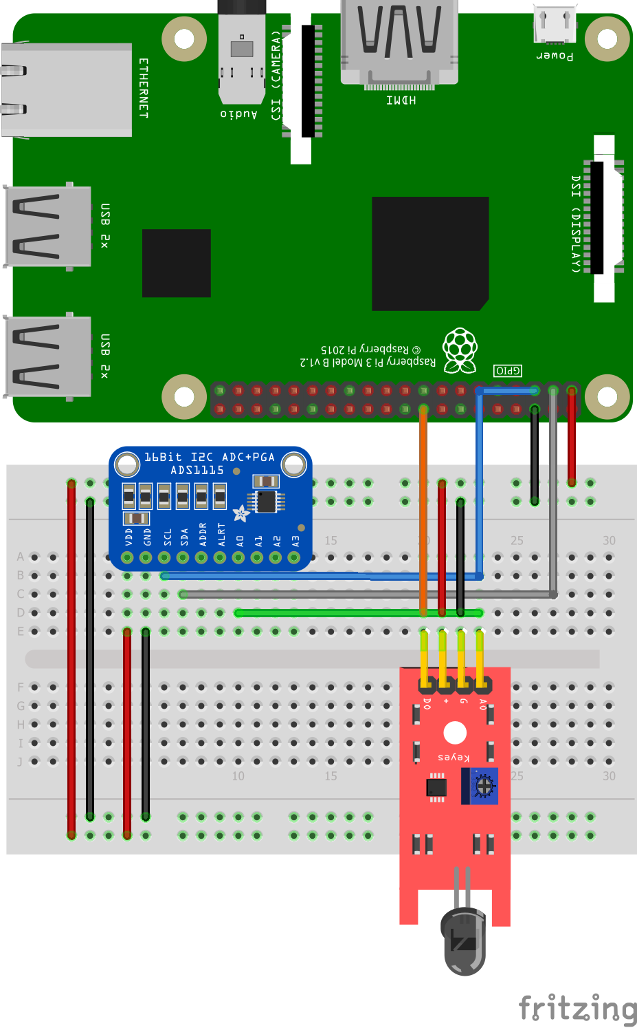
The modules have three pins and are easy to connect directly to the Pi’s GPIO header.
IR Sensors emit and receive Infrared radiation. They are often used as Proximity Sensors i.e. detect and alarm if an object is close to the sensor.
The 3 pins should be connected to the Pi as shown in the table below :
IR pin | Signals | Pi pins
1 | 3.3v | 3.3V
2 | Output | 11 (GPIO17)
3 | Ground | 6 or 9

Slide 8
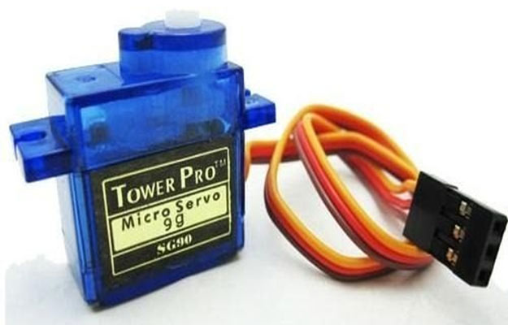
SERVO MOTOR:
It’s small size, low inertia and almost noise and frictionless operation makes the a.c. servomotor particularly attractive.
Setup(CONNECTIONS):
In most cases, the colors of the servo are as follows and are connected to the Pi:
Black – comes to GND (pin 6) from the Pi
Red – comes to 3V3 (pin 1) from the Pi
Yellow/Orange – to a free GPIO pin (e.g., GPIO17, pin 11)

Slide 9
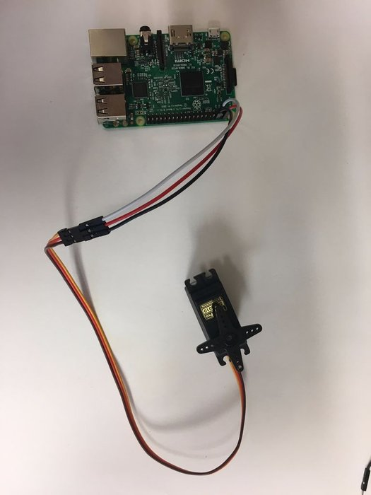
Advantages and disadvantages
Advantages:
Some of the advantages of servo motors are as follows:
High speeds
Available in all sizes
Low noise
Disadvantages:
More expensive
Cannot work open loop - feedback is required

Slide 10
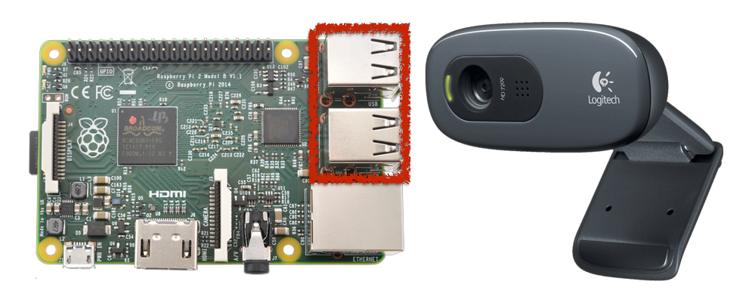
USB CAMERA
Starting from small houses to huge industries, surveillance plays very vital role to fulfill our safety aspects as Burglary and theft have always been a problem. In big industries personal security means monitoring the people’s changing information like activities, behavior for the purpose of protecting, managing and influencing confidential details.

Slide 11
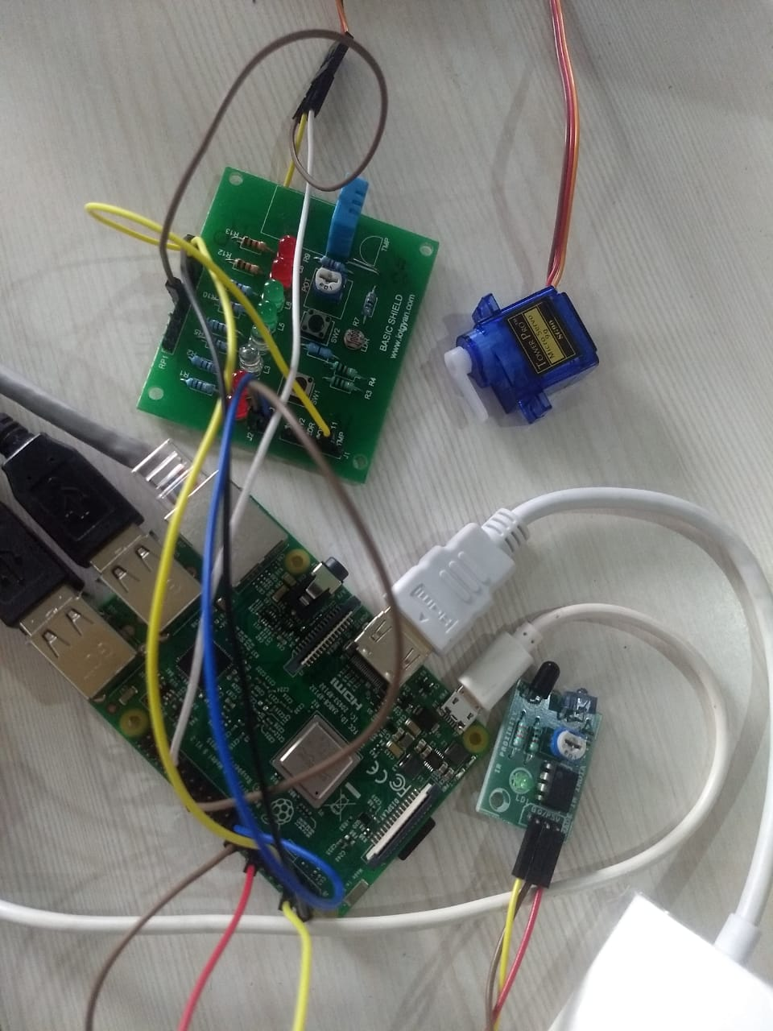
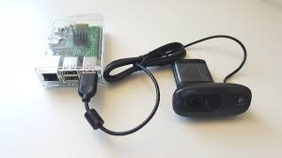
CIRCUIT CONNECTIONS

Slide 12
Block diagram
IR Sensor
Person Arrive
Raspberry pi
Camera
Web Service
Open Door Automatically
YES
Door remain Closed
User’s choice?
NO

Slide 13
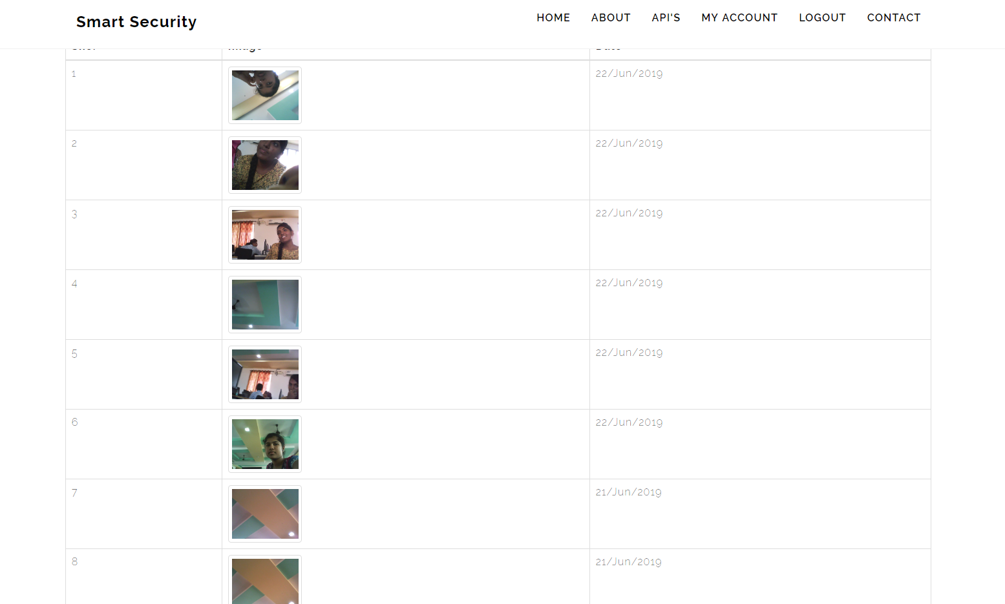

Slide 14
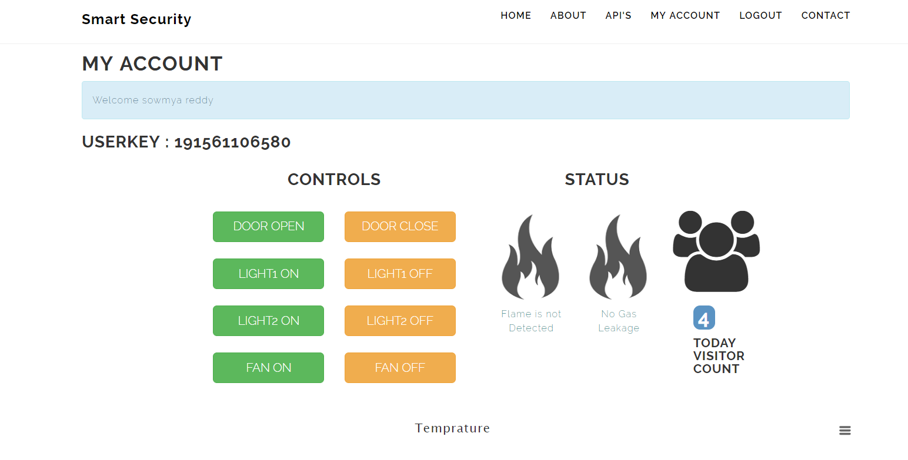

Slide 15

CONCLUSION
We designed the System which reduces human efforts and provide security. System provides Security locks for door, comfort, connivance security.
The security level is increased due to the usage of Raspberry Pi-3Model B which sends the images to the user. It has in built capabilities of connecting to external devices. Raspberry pi proves to be smart economic and efficient platform for implementing the home security system and for automation.

Slide 16



